Slide 1

Analyse: “Who will subscribe to the term deposit?”
Presenter : Basabdatta Ray

Slide 2
Business Objective
Introduction:
A Portuguese Banking Institution needs to understand which of their existing customers are most likely to invest in a term deposit. They launched a tele-marketing campaign to run an experiment on approx. 41000 customers and analyse the differences between the ones who do opt for a TD and the ones who do not.
Problem Statement:
As a data analyst I need to discover the differences between the 2 profile of the customers - customers who agree to procure a TD and customers who do not.
The aim is to identify the potential customers and focus more the customers that closely resemble the profile of the positive class. (Positive class = customers who agree to procure a TD and Negative class = customers who do not agree to procure a TD )
Impact:
Accurate target customer segmentation will help in achieving growth.
Discover potential markets and provide insights into the competitive market.
Develop or improve products to meet customer needs.
Maximize profit.
It will also help to meet the strategic goals for a particular product/service (here it is TD).

Slide 3
About The Data:
Independent features/variables:
'age','job','marital','education','housing','loan','contact','month','day_of_week','duration','campaign','pdays','previous','poutcome','emp.var.rate','cons.price.idx','cons.conf.idx','euribor3m','nr.employed’
Dependent/Target variable:
y = ‘yes’, Positive class
y = ‘no’, Negative class
Shape of the dataset:
- Total 41188 rows 20 columns including the target feature.
Data types:
- Out of total 20 columns there are 10 categorical columns and the rest are numerical. To handle the categorical columns according to their types (Nominal, Ordinal) I have used One-hot encoding, Label encoding technique etc.

Slide 4
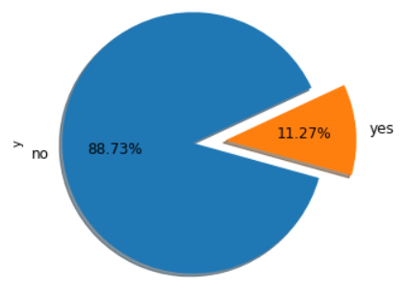
EDA:
Univariate Analysis: ‘y’
What proportion of the customers responded positive to the campaign:
Out of total 41188 customers only 11.27% responded positive to opt for the TD
The customer response proportion looks imbalanced.
We will handle this imbalanced data by using up-sampling or over-sampling technique like SMOTE
We will apply up-sampling technique on the minority class (i.e, positive class) to make it more balanced.

Slide 5
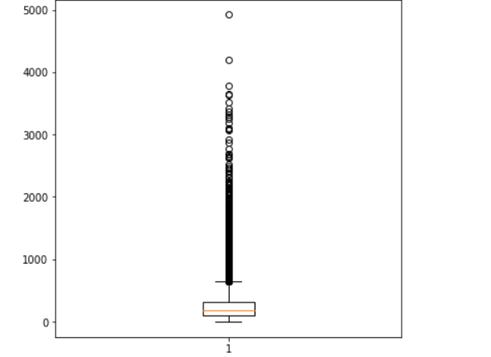
EDA:
Univariate Analysis: ’duration’
The boxplot implies the distribution of the Last contact duration, in seconds.
The 25% of the contact duration is approximately below 40seconds.
The 50% of the contact duration is approximately of 40-50seconds.
The 75% of the contact duration is approximately below 60seconds.
The data points above the upper bound whisker shows that there are many calls where the communication duration was much more higher than the usual duration.
These look like being outliers. But we will check using IQR if these are mild outliers or major outliers. And according to that we need to treat those outliers.
For such high duration contacts we need to check the respective respond if it was positive or not.

Slide 6
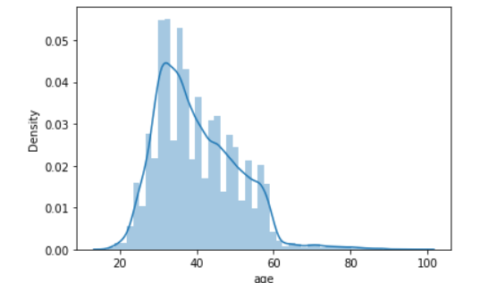
EDA:
Univariate Analysis: ‘Age’
It seems for the distribution of ‘age’ data that Age is not normally distributed across the dataset.
Customers of age above 80 were also contacted as part of this campaign. But taking new financial decision (like opening a new TD account) at this high age is rare scenario.
So here for this dataset, 80 years or older may not be a good representation of this dataset
Furthermore, there is a threshold at which children (below 18) re too young to be replying to the campaign, which we can see is also a part of this data.
Most of the target customers for this campaign are of age between 27-40 approximately.

Slide 7
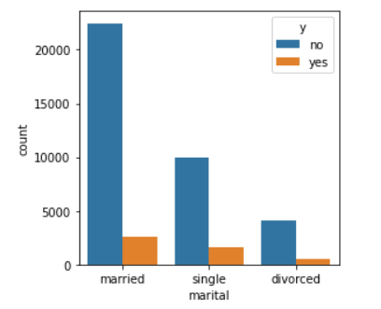
EDA:
Bivariate analysis: 'marital’ vs ‘y’
‘marital’ feature has total 3 categories present – ‘divorced’, ‘married’ and ‘single’
The count plot shows that mostly married and single people have opting for the TD.
Divorced people are contacted less in comparison to the other 2 categories and they opted less as well.
It seems single people were also contacted less in number than the married people, but proportion-wise they have responded a little higher than the married people.
So single people may be crucial contributors to opt for a TD.

Slide 8
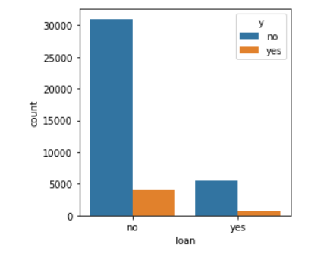
EDA:
Bivariate analysis: ‘loan’ vs ‘y’
- From the count plot It is clear that people who do not have personal loan are likely to opt for the TD.
- There are few people with loan who also opted for the TD but they are less in numbers wrt the 1st category.

Slide 9
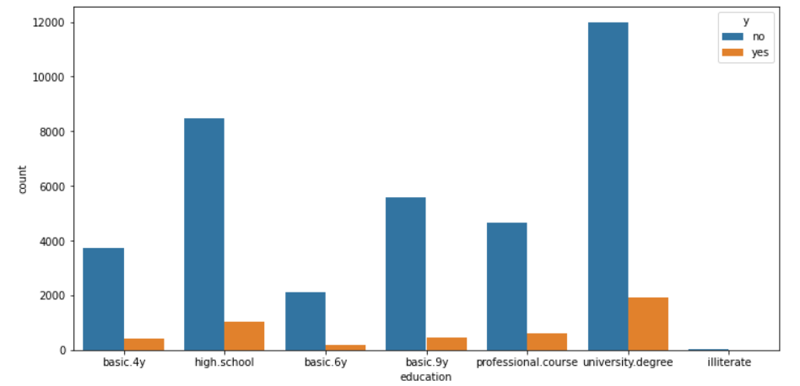
EDA:
Bivariate analysis: ‘education’ vs ‘y’
From the graph it shows that students with education background like 'high school' and 'university degree' are most likely to opt for the TD
So students can be a good target customer segment for the TD.

Slide 10
Feature Selection:
Using correlation and VIF these are the important features selected for model building:
Dropped 2 features- 'month’ and 'day_of_week’.
After dropping the correlated features the final selected features are: 'age','job','marital','education','default','housing','loan','contact','duration','campaign','pdays','previous','poutcome','emp.var.rate','cons.price.idx','cons.conf.idx','euribor3m','nr.employed'

Slide 11
Model Buidling:
Model building:
As this is a Binary classification problem I built the model with Logistic Regression, Decision Tree, Random Forest and KNN algorithms and then finally based on different evaluation metrics I compared these models.
Model | Accuracy | Recall (Positive class) | F1-Score
Logistic | 88% | 78% | 60%
DT | 88% | 82% | 62%
RF | 90% | 75% | 62%
KNN | 86% | 69% | 54%

Slide 12
Model Performance and Evaluation:
Aim Of The Model Is: As per the given requirement the focus should be more on the customers that closely resembles the profile of the positive class, i.e the customers who opted for the TD. Hence, I have tried to maximize the correct predictions for the positive class here. So, maximizing ‘Recall’ is the goal. Whichever model is able to predict the positive class accurately will be the best model of all.
Model Evaluation Metrics For This Problem Is : Recall And Accuracy
Among all the models Decision Tree model is giving the highest Recall after doing hyper parameter tuning and the accuracy is also good in comparison to other models.
Out of total predictions 88% of the predictions are accurately done by this model. Hence accuracy is high.
Out of total actual positive classes 82% of the time DT model is accurately predicting those as positive class. Hence Recall is also high here.
So we can consider it as a good model for this given dataset.

Slide 13
Thank you

